Slide 2
Mt.6:9-13
Our Father, which art in heaven, Hallowed be thy Name. Thy Kingdom come. Thy will be done in earth, As it is in heaven. Give us this day our daily bread. And forgive us our trespasses, As we forgive them that trespass against us. And lead us not into temptation, But deliver us from evil. For thine is the kingdom, The power, and the glory, For ever and ever. Amen.
Context…
Mt.6:1 - beware of practicing righteousness before men
Mt.6:8 - So, do not be like them
Mt.6:9 - Pray then in this way…

Slide 3
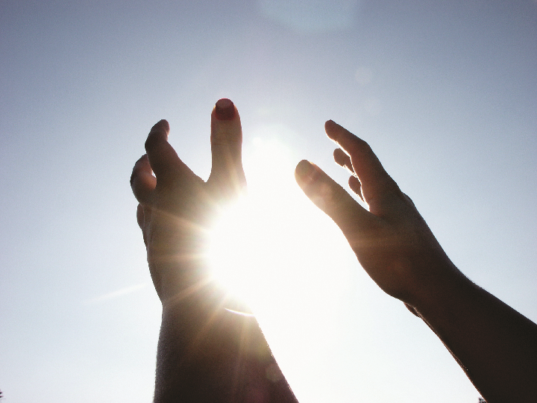
The Kind Of Prayer That Pleases God

Slide 4
Mt.6:9-13
Pray, then, in this way: Our Father who is in heaven, Hallowed be Your name. Your kingdom come. Your will be done, On earth as it is in heaven. 'Give us this day our daily bread. And forgive us our debts, as we also have forgiven our debtors. And do not lead us into temptation, but deliver us from evil. [For Yours is the kingdom and the power and the glory forever. Amen.'] For if you forgive others for their transgressions, your heavenly Father will also forgive you. But if you do not forgive others, then your Father will not forgive your transgressions.

Slide 5
The Kind Of Prayer That Pleases God
Your Kingdom Come
Prophesied - Dan.2:44
Jesus taught it’s near -Mt.4:17
With power - Mk.9:1; Lk.24:49; Acts 1:4-8; 2:1-4
Col.1:13 - He has rescued us from the domain of darkness and transferred us to the Kingdom of His beloved Son

Slide 6
Mt.6:9-13
Pray, then, in this way: Our Father who is in heaven, Hallowed be Your name. Your kingdom come. Your will be done, On earth as it is in heaven. 'Give us this day our daily bread. And forgive us our debts, as we also have forgiven our debtors. And do not lead us into temptation, but deliver us from evil. [For Yours is the kingdom and the power and the glory forever. Amen.'] For if you forgive others for their transgressions, your heavenly Father will also forgive you. But if you do not forgive others, then your Father will not forgive your transgressions.

Slide 7
The Kind Of Prayer That Pleases God
Your Will Be Done On Earth As It Is In Heaven
Rev.21:27
Mt.28:18-20
Eccl.12:13-14
Jn.5:30
Mt.26:39
Mt.12:46-50

Slide 8
Mt.6:9-13
Pray, then, in this way: Our Father who is in heaven, Hallowed be Your name. Your kingdom come. Your will be done, On earth as it is in heaven. Give us this day our daily bread. And forgive us our debts, as we also have forgiven our debtors. And do not lead us into temptation, but deliver us from evil. [For Yours is the kingdom and the power and the glory forever. Amen.'] For if you forgive others for their transgressions, your heavenly Father will also forgive you. But if you do not forgive others, then your Father will not forgive your transgressions.

Slide 9
The Kind Of Prayer That Pleases God
Give Us This Day Our Daily Bread
Acts 17:25, 28
Mt.7:7-11
Js.4:2-3 / 1Tim.6:6-12
Eph.4:28 / 1Ths.4:9-12
Js.1:17

Slide 10
The Kind Of Prayer That Pleases God
Give Us This Day Our Daily Bread
Back of the loaf is the flour,
And back of the flour, the mill,
And back of the mill is the wheat,
That waveth on yonder hill.
And back of the hill is the sun,
And the rain and the Father’s will
Acts 14:16-17

Slide 11
Mt.6:9-13
Pray, then, in this way: Our Father who is in heaven, Hallowed be Your name. Your kingdom come. Your will be done, On earth as it is in heaven. Give us this day our daily bread. And forgive us our debts, as we also have forgiven our debtors. And do not lead us into temptation, but deliver us from evil. [For Yours is the kingdom and the power and the glory forever. Amen.'] For if you forgive others for their transgressions, your heavenly Father will also forgive you. But if you do not forgive others, then your Father will not forgive your transgressions.

Slide 12
The Kind Of Prayer That Pleases God
Forgive Us Our Debts As We Have Forgiven Our Debtors
Lk.11:4 - forgive us our sins
Rom.6:23
1Cor.15:57 / Eph.1:7
Lk.6:36-37
Rom.1:31 - unmerciful
2Tim.3:3 - irreconcilable
Mt.6:14-15
Mt.18:21-35

Slide 13
Mt.6:9-13
Pray, then, in this way: Our Father who is in heaven, Hallowed be Your name. Your kingdom come. Your will be done, On earth as it is in heaven. Give us this day our daily bread. And forgive us our debts, as we also have forgiven our debtors. And do not lead us into temptation, but deliver us from evil. [For Yours is the kingdom and the power and the glory forever. Amen.'] For if you forgive others for their transgressions, your heavenly Father will also forgive you. But if you do not forgive others, then your Father will not forgive your transgressions.

Slide 14
The Kind Of Prayer That Pleases God
And Do Not Lead Us Into Temptation But Deliver Us From Evil
Js.1:13
Thayer’s - adversity, affliction, trouble sent by God and serving to test or prove one’s faith, holiness, character
Mt.26:41
Mt.13:19, 38
Mt.4:4
Heb.12:4-13 / 1Pet.1:6-9
1Cor.10:13 / Heb.13:5 / 2Tim.4:16-18
Lk.18:31-33 / Acts 2:31 / 1Pet.2:23

Slide 15
Mt.6:9-13
Pray, then, in this way: Our Father who is in heaven, Hallowed be Your name. Your kingdom come. Your will be done, On earth as it is in heaven. Give us this day our daily bread. And forgive us our debts, as we also have forgiven our debtors. And do not lead us into temptation, but deliver us from evil. [For Yours is the kingdom and the power and the glory forever. Amen.] For if you forgive others for their transgressions, your heavenly Father will also forgive you. But if you do not forgive others, then your Father will not forgive your transgressions.

Slide 16
We have a God…
Rules with power, wisdom, righteousness, love, mercy
Doesn’t ignore our needs; listens, cares, comes to our aid
Is worthy of our adoration, love, faithful service
Mt.6:33
Heb.12:28

