Slide 2
The God Approved Giver
2Tim.2:15 - “Be diligent to present yourself approved to God, as a workman who does not need to be ashamed, accurately handling the Word of Truth”
Jn.4:24 - “God is Spirit and those who worship Him must worship Him in spirit and in Truth”
Gives…
Sacrificially
Cheerfully / willingly
As prospered
Liberally
Purposefully
Secretly

Slide 3
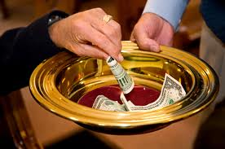
The God Approved Giver
We must not be too concerned with material things
Mt.19:16-26
Col.3:2

Slide 4
The God Approved Giver
We must be good stewards of our money
1Cor.4:1-2
Js.1:17
1Tim.6:17-18

Slide 5
The God Approved Giver
We must be convinced of the worth of the object of our giving
2Cor.8:4
Ex.35:4-9, 20-29; 36:3-7
Support of preachers
Benevolent aid
Bibles
Song books
Class material
Teaching literature
Tracts
Bulletins
Printing tools
Teaching tools
Meeting place & upkeep
Supplies
etc.

Slide 6
The God Approved Giver
We must feel a personal responsibility to do our share
1Tim.3:15
Rom.12:4-5
Eph.4:16

Slide 7
The God Approved Giver
We must truly appreciate our blessings
Jn.3:16
Rom.8:32
Mt.16:26
Brownlow…
What I saved I lost
What I spent I used
What I gave I have
Mt.6:19-21

Slide 8
The God Approved Giver
Bring in our hands what we find in our heart
Mt.22:37
Love the Lord your God with all your heart, soul & mind

