Slide 1
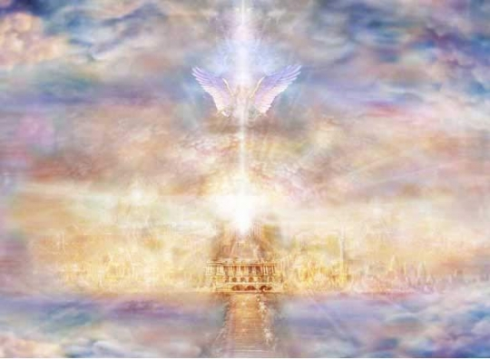
A New Heavens And Earth
A new order of things
(Context - what does it have reference to?)
Isa.65:17; 66:22
Rev.21:1
2Pet.3:13

Slide 2
A New Heavens And Earth
Isa.65:17; 66:22
Isa.58 - hypocritical religion
Isa.59 - redeem from exile
Isa.60-62 - return of exiles
Isa.63-64 - plea for mercy, acknowledge sin & dependence on God

Slide 3
A New Heavens And Earth
Isa.65:1-7…
Israel - didn’t seek Him, stubborn, rebellious, remnant would return
Messianic - Jews reject Messiah, God would seek the Gentiles
(Rom.10:16-21; Isa.53:1; Acts 13:46)

Slide 4
A New Heavens And Earth
Isa.65:8-16…
Israel - remnant return to land; prosperous once again
Messianic - spiritual prosperity in Christ

Slide 5
A New Heavens And Earth
Isa.65:17-25…
Israel - a new condition of life… peace, joy, prosperity, harmonious relationship with God
Messianic - a new existence, a new age, a new order of things, a new relationship with God

Slide 6
A New Heavens And Earth
Isa.65:17; 66:22
a new dispensation; new order of things
Parallel then & now - sin, repentance, restoration, new wonderful relationship with God
NOT a reference to a new physical heavens & earth

Slide 7
A New Heavens And Earth
John’s Vision: Rev.21:1
(a new heaven & earth)
Either…
Final victory of church in Heaven
Victorious state of church in First Century after the defeat of their persecutors
or…

Slide 8
A New Heavens And Earth
Rev.21:9-10
“…come here, I will show you the bride, the wife of the lamb” … “And he carried me away in the Spirit to a great and high mountain, and showed me the holy city, Jerusalem, coming down out of Heaven from God”
a people (described as a city)
Rev.21:2; Heb.12:22-24

Slide 9
A New Heavens And Earth
John’s Vision: Rev.21:1
(a new heaven & earth)
View - It refers to our glorious home in Heaven…
Chapters 12-21…
Child is born to woman (Christ)
Satan uses his agents to persecute church
God gives church victory over enemies
Final conflict when Satan is destroyed
Final judgment of mankind
Punishment of wicked
Reward of righteous (Thus… chap.21 “Heaven”)

Slide 10
A New Heavens And Earth
John’s Vision: Rev.21:1
(a new heaven & earth)
View - It refers to our glorious home in Heaven…
Parallels teaching of 2Pet.3…
Judgment & destruction of evil men (2Pet.3:7 - Rev.20:13)
Passing of present heavens & earth (2Pet.3:10 - Rev.20:11)
Blessing of new heavens & earth (2Pet.3:13 - Rev.21:1)

Slide 11
A New Heavens And Earth
John’s Vision: Rev.21:1
(a new heaven & earth)
View - It refers to the state of God’s people after deliverance from their persecutors…
a new order of things
old conditions, enemies & powers have passed away
a new way of life following period of persecution
church come forth as a bride for her husband ready to evangelize the world

Slide 12
A New Heavens And Earth
Applications
Isa.65 Isa.66 2Pet.3 Rev.21
God is always ready to respond when we sincerely call upon Him (cf. Ps.15:1-2) … (Lk.15:11-32)
God stands ready to forgive but one day our time will run out (2Pet.3:9; Ps.90:12)
To not seek God is rebellion (Acts 17:26-27; Isa.59:1-2)
Can be faithful although surrounded by many who aren’t (Phlm.4-7)
Those who faithfully serve God will have a glorious future (Eph.1:3; Jn.11:25-26)

Slide 13
A New Heavens And Earth
A New Dwelling Place
Php.3: 18-21 - eagerly wait
Heb.9:27-28 (cf. 2Tim.4:6-8)
2Cor.5:7
Ps.116:15 … 1Ths.4:13
Rev.22:17-21 - “Come Lord Jesus”!!!

