Slide 1
Does it matter which church I’m a part of?
Why are there so many churches?
How Can I Know Which Church is Right?
Which church is right?

Slide 2
CHAPTER 1: THE BEGINNING
but you shall receive power when the Holy Spirit has come upon you; and you shall be My witnesses both in Jerusalem, and in all Judea and Samaria, and even to the remotest part of the earth." Acts 1:8
church of God
to the church of God which is at Corinth, to those who have been sanctified in Christ Jesus, saints by calling, with all who in every place call upon the name of our Lord Jesus Christ, their Lord and ours: 1 Corinthians 1:2
Brethren, join in following my example, and observe those who walk according to the pattern you have in us
Philippians 3:17
sanctified
saints
Judea
remotest part
Samaria
of the earth

Slide 3
CHAPTER 1: THE BEGINNING
CHAPTER 2: THE DEPARTURE
But false prophets also arose among the people, just as there will also be false teachers among you, who will secretly introduce destructive heresies, even denying the Master who bought them, bringing swift destruction upon themselves. 2 Peter 2:1
Drifting from the Truth
“People do not usually buy into false doctrines purposely. They err because of laziness, ineptness, carelessness, or foolishness in handling the Scriptures.”
For the time will come when they will not endure sound doctrine; but wanting to have their ears tickled, they will accumulate for themselves teachers in accordance to their own desires; 2 Timothy 4:3
I know that after my departure savage wolves will come in among you, not sparing the flock; and from among your own selves men will arise, speaking perverse things, to draw away the disciples after them. Acts 20:29-30
I am amazed that you are so quickly deserting Him who called you by the grace of Christ, for a different gospel; Galatians 1:6

Slide 4
A.D.150 – Infant Baptism Practiced
A.D.250 – Sprinkling for baptism practiced
A.D.255 – Distinction between elders and bishops
A.D.430 – Worship of Mary
A.D.600 – Prayers to Mary and dead saints
A.D.660 – Instruments of Music
A.D.788 – Worship of Relics

Slide 5
CHAPTER 1: THE BEGINNING
CHAPTER 2: THE DEPARTURE
elders
among you
Therefore, I exhort the elders among you, as your fellow elder and witness of the sufferings of Christ, and a partaker also of the glory that is to be revealed, shepherd the flock of God among you, exercising oversight not under compulsion, but voluntarily, according to the will of God; and not for sordid gain, but with eagerness; nor yet as lording it over those allotted to your charge, but proving to be examples to the flock. 1 Peter 5:1-3
Paul and Timothy, bond-servants of Christ Jesus, to all the saints in Christ Jesus who are in Philippi, including the overseers and deacons: Philippians 1:1
Drifting from the Truth
shepherd
The Development of an Organization Larger than the Local Church
among you
oversight
allotted to your charge

Slide 6
Universal Bishop
Regional Bishop
Regional Bishop
Bishop
Bishop
Bishop
Elders
Elders
Elders
Elders
Church
Church
Church
Church

Slide 7
CHAPTER 1: THE BEGINNING
Philip Schaff: “When controversies arose concerning the true meaning of the Scriptures, it became necessary to give formal expression of their true sense, to regulate the public teaching of the Church, and to guard it against error. In this way the creeds were gradually enlarged and multiplied, even to the improper extent of theological treatises and systems of divinity.”
(Creeds of Christendom, Vol. 1, pg. 6)
CHAPTER 2: THE DEPARTURE
Drifting from the Truth
The Development of an Organization Larger than the Local Church
The Dethroning of God’s Word

Slide 8
A.D. 325 – Council of Nicean
A.D. 431 – Council of Ephesus
A.D. 896 – Council of Constantinople
A.D. 1229 – Council of Tolouse
But in vain do they worship Me, Teaching as doctrines the precepts of men.’” Matthew 15:9

Slide 9
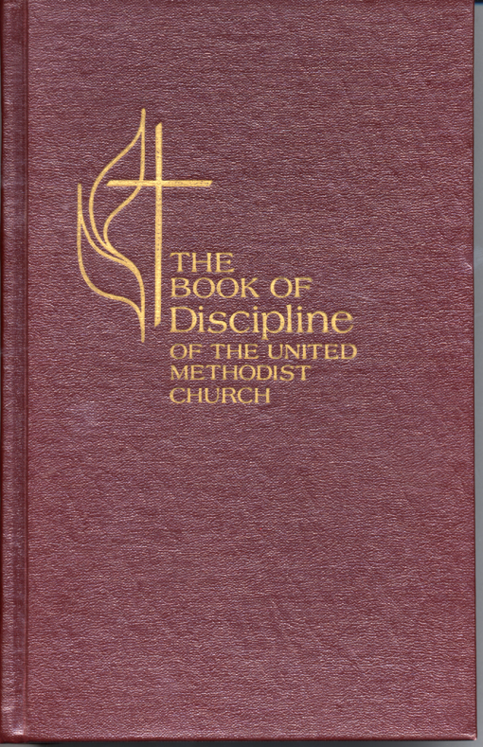
Methodist Church: “The Discipline is the book of law of the United Methodist Church. It is the product of many general conferences of historic religious bodies which now form the United Methodist Church. The Discipline as the instrument for setting forth the laws, plan, polity, and process by which United Methodist’s govern themselves remains constant. Each general conference modifies, elaborates, clarifies and adds its own contribution to the Discipline” (Discipline, pg. 5)

Slide 10
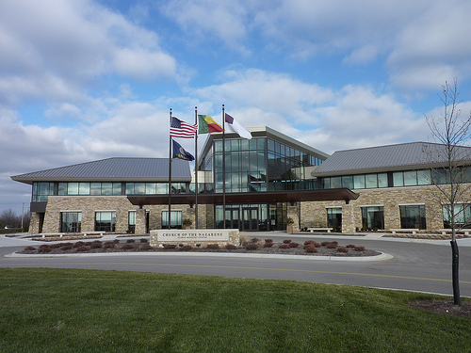
Nazarene Church: “We do hereby ordain, adopt, and set forth, as the fundamental law or constitution of the Church of the Nazarene, the Articles of Faith, the General rule, and the Articles of Organization and Government” (Preamble of Constitution of Church of Nazarene)

Slide 11
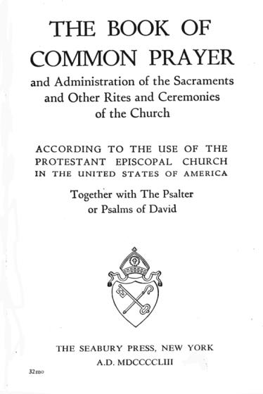
Episcopalian Church: “Laws enacted at the tri-annual General Convention of Bishops are Canon Law and define the rules and procedures by which the church and its members are to live” (A New Dictionary for Episcopalians, pg. 34)

Slide 12
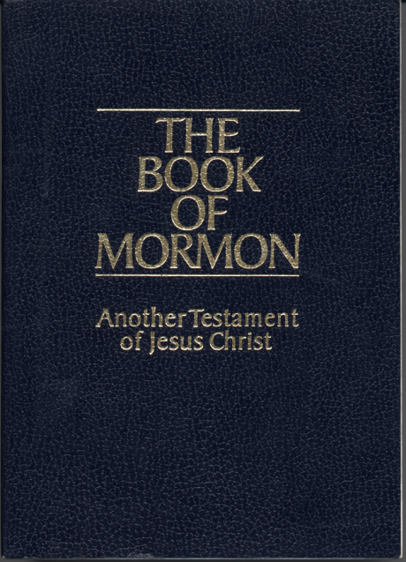
Mormon Church: “Revelation for the direction of the entire Church comes from God to the President of the Church” (Global Media Guide)

Slide 13
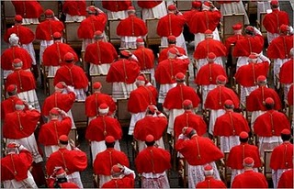
Catholic Church: “When either the Roman Pontiff of the body of bishops together with him defines a judgment, they pronounce it in accord with revelation itself. All are obliged to maintain and be ruled by this revelation” (Vatican II, Dogmatic Constitution, pg. 22)

Slide 14
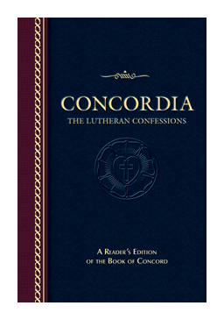
Lutheran Church: “The cementing force in American Lutheranism must be sought in a loyalty to the Lutheran Confessions” (Our Church and Others, pg. 24)
“If someone asks a Lutheran: 'What does the Lutheran church teach?’, or ‘What do you as Lutherans believe?’ He can direct the inquirer to the Lutheran confessions.” (Ibid, pg. 25)

Slide 15
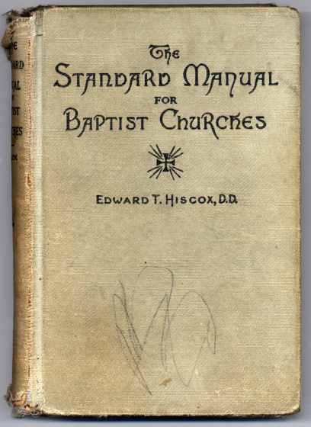
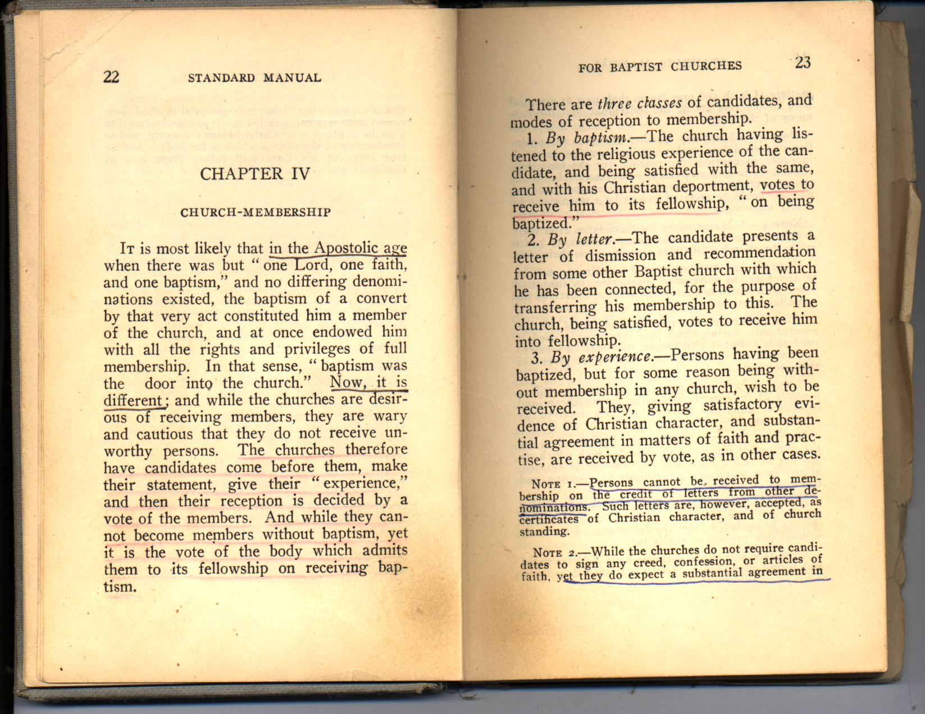
Hiscox, Standard Manual for Baptist Churches

Slide 16
CHAPTER 1: THE BEGINNING
Indulgences are the most precious and most noble of God’s gifts…come and I will give you letters, all properly sealed, by which even the sins you intend to commit may be pardoned. I would not change my privileges for those of Saint Peter in Heaven, for I have saved more souls by my indulgences than the apostle by his sermons. There is no sin so great that an indulgence can not remit…at the very instant that the money rattles in the bottom of the chest the soul escapes from purgatory and flies liberated to heaven.” – John Tetzel
CHAPTER 2: THE DEPARTURE
CHAPTER 3: THE REFORMATION

Slide 17
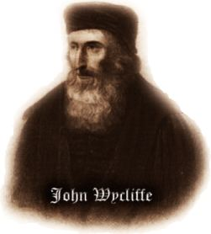
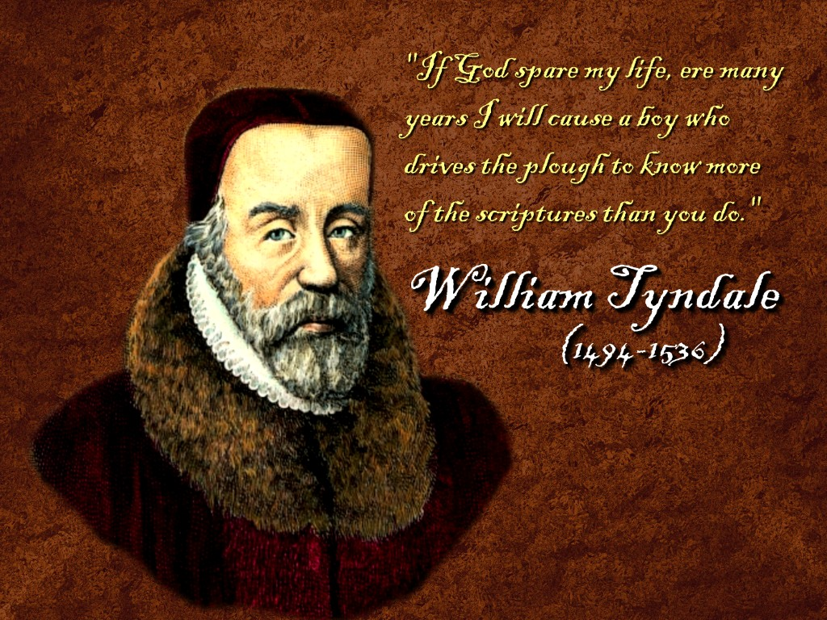
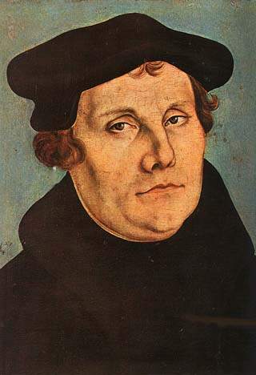
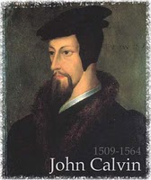
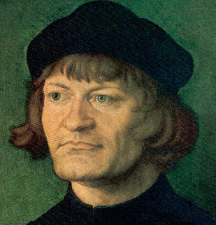
1328-1384
Martin Luther
1483-1546
What is crooked cannot be straightened, and what is lacking cannot be counted. Ecclesiastes 1:15
Ulrich Zwingli
1484-1531

Slide 18
CHAPTER 1: THE BEGINNING
CHAPTER 2: THE DEPARTURE
CHAPTER 3: THE REFORMATION
CHAPTER 4: THE RESTORATION

Slide 19
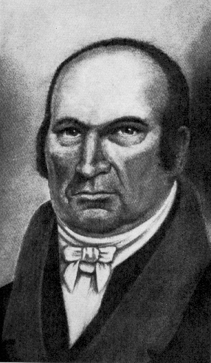
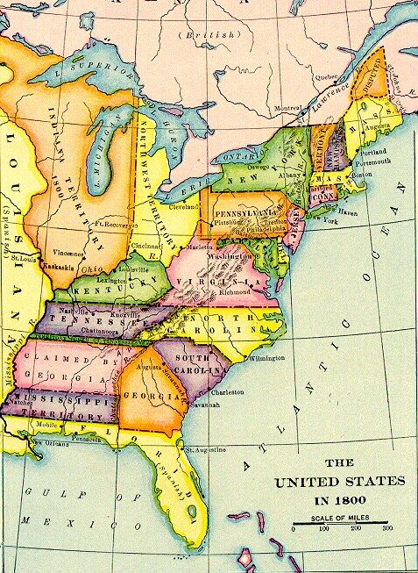
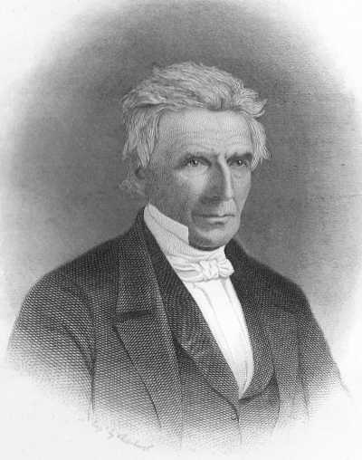
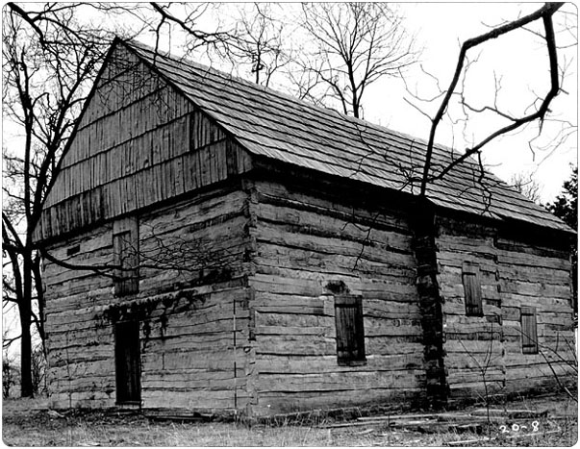
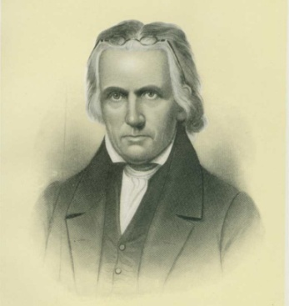
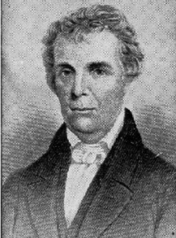
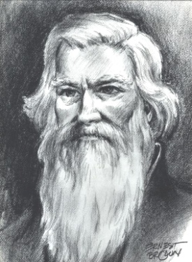
Abner Jones
Thomas Campbell
Alexander Campbell
James O’ Kelly
Barton Stone

Slide 20
Does it matter which church I’m a part of?
and when he had found him, he brought him to Antioch. And it came about that for an entire year they met with the church, and taught considerable numbers; and the disciples were first called Christians in Antioch. Acts 11:26
And whatever you do in word or deed, do all in the name of the Lord Jesus, giving thanks through Him to God the Father. Colossians 3:17

Slide 21
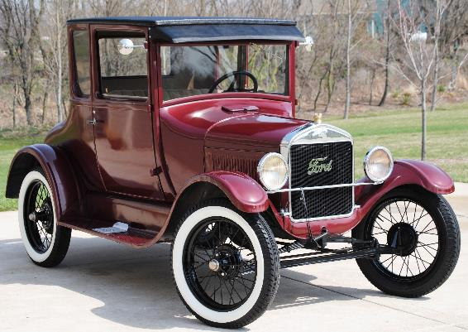
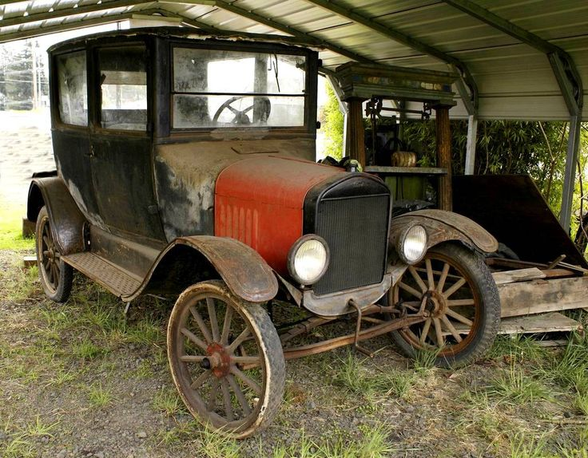
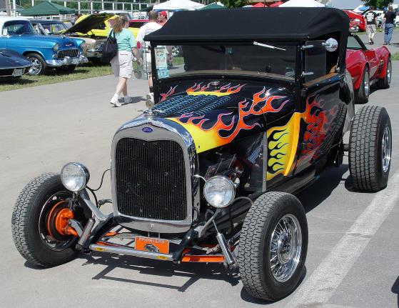
The things you have learned and received and heard and seen in me, practice these things; and the God of peace shall be with you. Philippians 4:9

Slide 22
How Can I Know Which Church is Right?

